Slide 1

Object Detection Using Deep Learning
Achyuth Reddy Kanumanthu
Yuvaraj Sriramoju
Vamshi Kalyan Yerramilli

Slide 2

Problem Statement
Our project aims to implement deep learning techniques for object detection with ultimate goal of developing a deep leaning model which is capable of detecting and localizing the objects accurately.
Object detection involves image classification and semantic instance segmentation. Even though CNN has made a huge revolution in the field of classification, the basic CNN has its own limitations.
We'll utilize techniques like Fast R-CNN, YOLO to identify and locate objects within the images.

Slide 3
Problem Statement
The goal is not just to classify objects but also to precisely pinpoint their positions in the picture.
The project will explore various deep learning architectures and training methodologies to achieve the desired level of accuracy and efficiency.
The project also studies the adaptability of architectures on different datasets.

Slide 4
Motivation
In the current world, Deep Learning has emerged as a powerful tool in almost all the fields.
Object Detection plays a huge role in different fields such as in Autonomous driving, surveillance, and healthcare.
These applications showcase the versatility and importance of object detection in improving efficiency, safety, and decision-making across diverse industries.
In object detection, deep learning frameworks play a crucial role in detecting and localizing objects. The ability to detect objects has become essential across various industries.

Slide 5

Motivation
From autonomous vehicles to surveillance systems, the demand for these object detection algorithms has enormously increased.
Even though CNN had made a huge revolution in the field of Image Classification, it lacks the ability to obtain more information due to its structural limitations by convolutional operations.
They can struggle in extracting the features and might take a long time to detect the objects.

Slide 6
Related Work
Previously there were many works related to Object Detection using Deep Learning.
Early object detection methods relied on handcrafted features and techniques like Haar cascades and Histogram of Oriented Gradients (HOG).
Ross Girshik [1] & [2] proposed a Region based Convolutional Neural Network for the detection of objects and semantic segmentation.
The architectures such as Single Shot Multibox Detector (SSD) [3] and You Only Look Once (YOLO) [4] improved speed and accuracy by predicting bounding boxes and class probabilities in a single pass.

Slide 7
Related Work
K. He et al. proposed Spatial Pyramid Pooling Networks (SPPNet) [5]. They introduced Spatial Pyramid Pooling (SPP) layer, which enables a CNN to generate a fixed-length representation regardless of the size of the image/region of interest without rescaling it.
T.-Y. Lin et al. proposed FPN [6]. A topdown architecture with lateral connections is developed in FPN for building high-level semantics at all scales. Since a CNN naturally forms a feature pyramid through its forward propagation, the FPN shows great advances for detecting objects with a wide variety of scales.

Slide 8
Deep Learning Models for Object Detection
YOLO
Fast R-CNN
Detectron
TensorflowV2

Slide 9

Methodology
YOLO (You Only Look Once)
YOLO is a Single Stage Detector.
It processes image in a single pass, making its performance significantly faster.
YOLOv5 uses a Deep Neural Networks as backbone to form image features.
YOLO is designed to directly predict bounding boxes and class probabilities by eliminating the complex post-processing steps and improving efficiency.
YOLO can detect a wide range of objects in various environments, making it suitable for many applications.
The optimized architecture of YOLO allows for efficient deployment on different platforms without compromising performance.

Slide 10
Methodology
Data Acquisition
We gather the data from Flickr and other data sources
There are around 5012 images classified into 20 different categories.
['person', 'car', 'chair', 'bottle', 'pottedplant', 'bird', 'dog','sofa', 'bicycle', 'horse', 'boat','motorbike’,cat','tvmonitor','cow','sheep','aeroplane','train','diningtable','bus’]
Data Pre-Processing:
We label the objects in the images using “LABELIMG”.
XML file is generated for each image indicating the properties of the objects in the image.

Slide 11

Methodology
Model Building
We loaded the pre-trained model and built the model accordingly.
Model Training and Testing
We trained the model and initialized weights and tested on various images.
We tuned hyperparameters to get better performance.
We initialized epochs = 150, batch_size = 8.
Deployment
We save the model version with the best performance and will deploy.

Slide 12
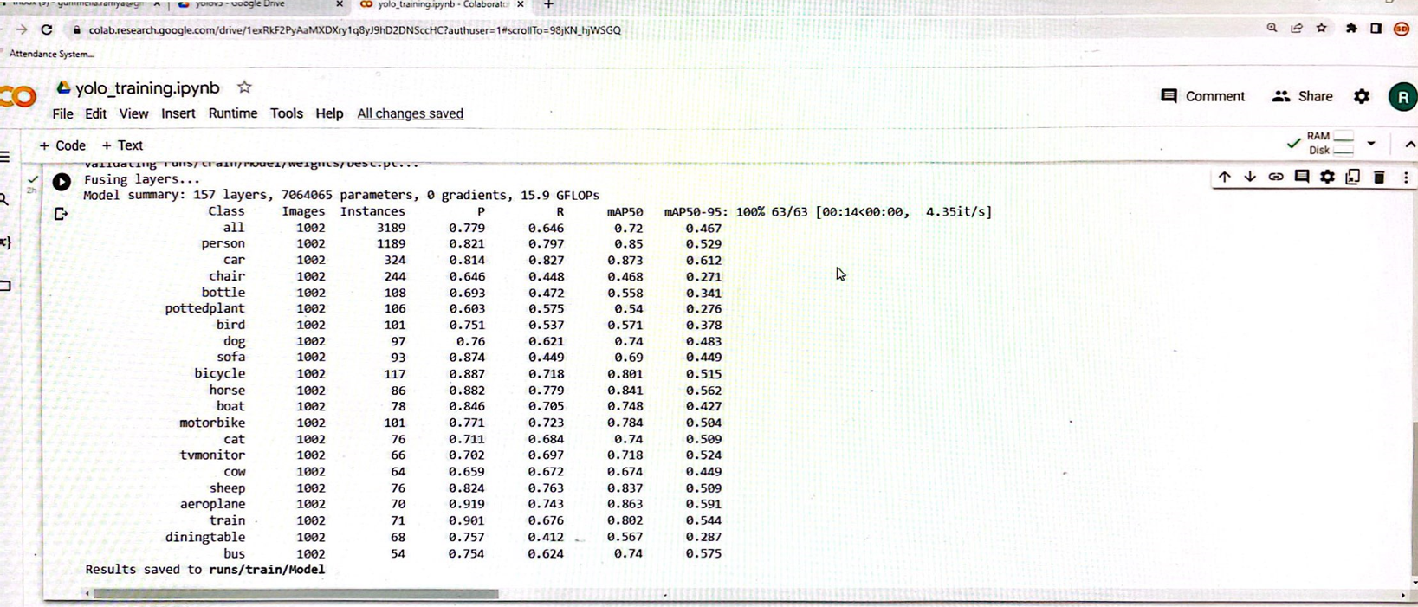
Experimental Results
The following are the results of the YOLOv5 model

Slide 13
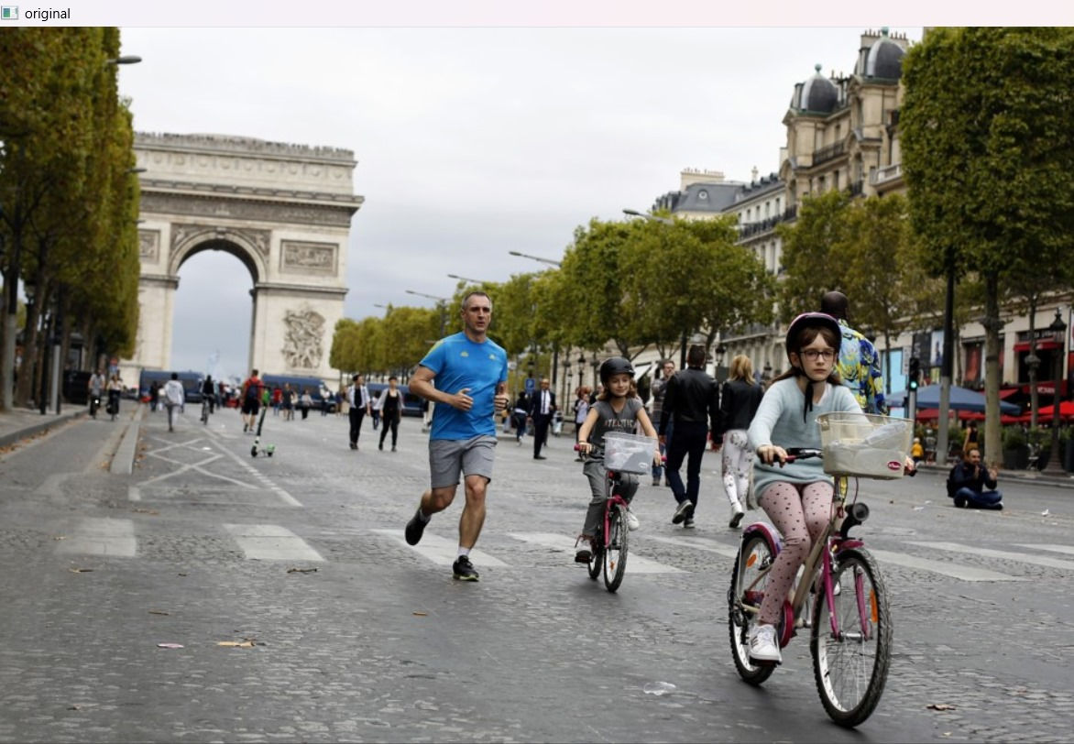
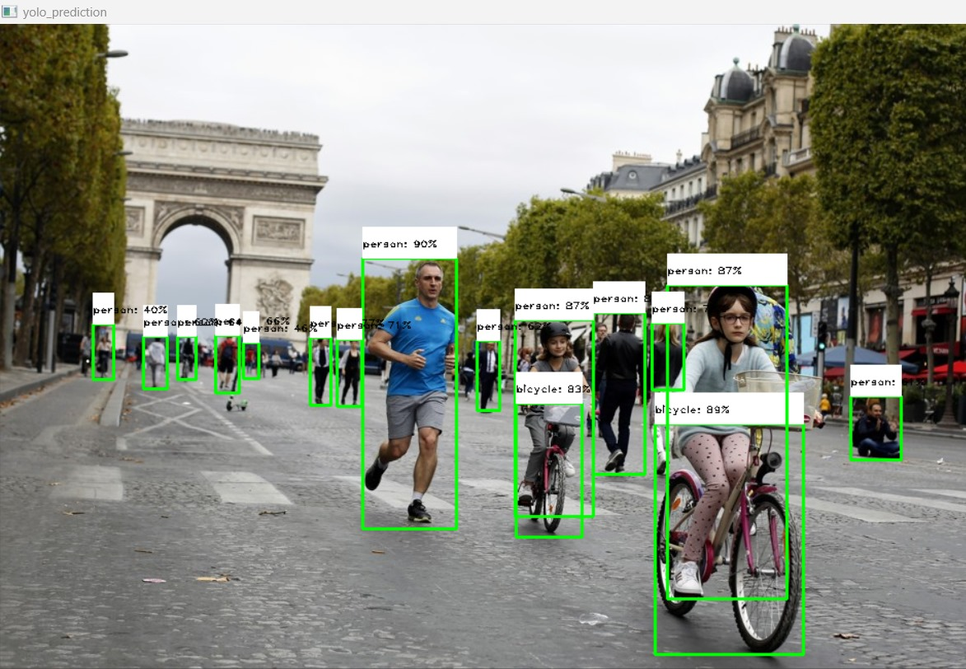
Experimental Results
Sample Input
Sample Output

Slide 14

Limitations
YOLO required larger training data to achieve state-of-art performance. Our dataset has limited data, which might affect accuracy.
Our project is only limited to detect objects in the Images. In our future work we plan to implement our model on videos also

Slide 15
Conclusion
We successfully implemented YOLOv5 and achieved good accuracy and performance in detecting objects
We optimized model hyperparameters and training strategies for better object detection results.
The project not only demonstrates the potential of deep learning in computer vision, but it also creates opportunities for significant uses in autonomous systems, surveillance, and healthcare.

Slide 16
References
[1] Rich feature hierarchies for accurate object detection and semantic segmentation Tech report (v5) Ross Girshick Jeff Donahue Trevor Darrell Jitendra Malik UC Berkeley.
[2] Fast R-CNN Ross Girshick Microsoft Research.
[3] SSD: Single Shot MultiBox Detector, Wei Liu, Dragomir Anguelov, Dumitru Erhan, Christian Szegedy, Scott Reed, Cheng-Yang Fu, Alexander C. Berg.
[4] You Only Look Once: Unified, Real-Time Object Detection Joseph Redmon, Santosh Divvala, Ross Girshick, Ali Farhadi University of Washington, Allen Institute for AI, Facebook AI Research.
[5] K. He, X. Zhang, S. Ren, and J. Sun, “Spatial pyramid pooling in deep convolutional networks for visual recognition,” in ECCV. Springer, 2014, pp. 346–361.
[6] T.-Y. Lin, P. Dollar, R. B. Girshick, K. He, B. Hariharan and S. J. Belongie, “Feature pyramid networks for object detection.” in CVPR, vol. 1, no. 2, 2017, p. 4
[7] Yolo v5 - https://github.com/ultralytics/yolov5.git

